Slide 1
Accessible Template Design Catalog
Select the appropriate layout to fit your presentation needs.
August 2023

Slide 2
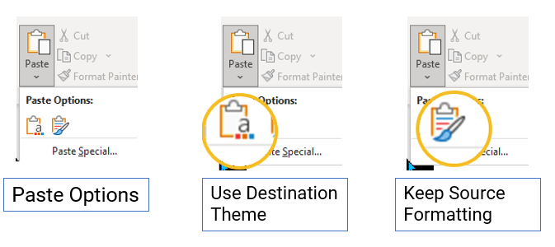
How to Use this Template – Template Designer
Open a blank presentation or one of your own.
Click View > Slide Master > to open the presentation in Slide Master view.
You can copy and paste slide layouts from this template into one of your own.
Select the appropriate Paste option > Use Destination Theme or Keep Source Formatting.
For step-by-step instruction or to learn how to set up the Reading Order of complex designs, download Design PPT Templates for Accessibility Design Catalog Supplemental - IAAF2023.docx.
Notes:
https://www.section508.gov/iaaf/

Slide 3
Terminology
Author
The Author is the person responsible for creating the presentation. They work in Normal view.
The Author selects slide layouts that fit their presentation needs.
The Author is responsible for ensuring the presentation passes the Microsoft Accessibility Check Inspection Results and any applicable 508 requirements.
Template Designer
The Template Designer designs slide layouts with universal accessibility features. The Template Designer works in Slide Master view.
Distribute templates to users and provide training as needed.
Notes:
Sometimes they are the same person. If not, then each plays a role in ensuring the presentation is accessible.

Slide 4
How to Use this Template – Author
Click File > Save As
Save this file – use a descriptive filename.
Click Home > New Slide > Select the appropriate layout.
If you cannot find a layout to fit your needs – Think Outside the Box! (See Workbook)
Upon completion, click Review > Check Accessibility > correct any issues found – apply the appropriate HHS Checklist Requirements.
Decrease the file size and save the document. (See Workbook)
To learn how to update this template, address accessibility issues triggered by the Microsoft Accessibility Checker, and apply HHS Checklist requirements, download Design PPT Templates for Accessibility Workbook - IAAF2023.docx.

